Slide 1
Classification

Slide 2
Species of Organisms
There are 13 billion known species of organisms
This is only 5% of all organisms that ever lived!!!!!
New organisms are still being found and identified

Slide 3
What is Classification?
Classification is the arrangement of organisms into orderly groups based on their similarities
Classification is also known as taxonomy
Taxonomists are scientists that identify & name organisms

Slide 4
Benefits of Classifying
Accurately & uniformly names organisms
Prevents misnomers such as starfish & jellyfish that aren't really fish
Uses same language (Latin or some Greek) for all names
Sea”horse”??

Slide 5
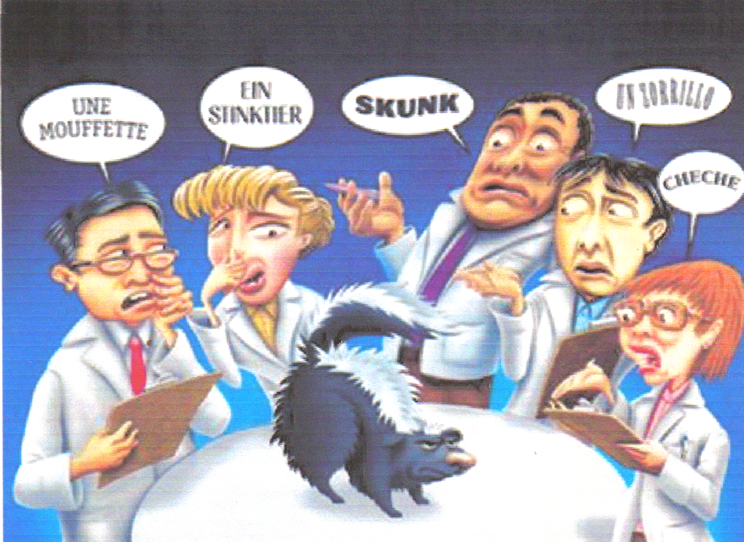
Confusion in Using Different Languages for Names

Slide 6
Latin Names are Understood by all Taxonomists

Slide 7
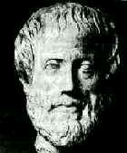
Early Taxonomists
2000 years ago, Aristotle was the first taxonomist
Aristotle divided organisms into plants & animals
He subdivided them by their habitat ---land, sea, or air dwellers

Slide 8
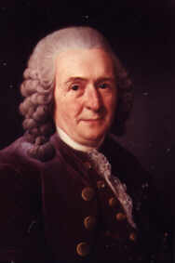
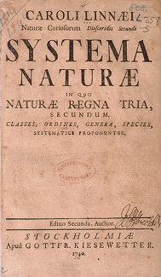
Carolus Linnaeus 1707 – 1778
18th century taxonomist
Classified organisms by their structure
Developed naming system still used today

Slide 9
Carolus Linnaeus
Called the “Father of Taxonomy”
Developed the modern system of naming known as binomial nomenclature
Two-word name (Genus & species)

Slide 10
Standardized Naming
Binomial nomenclature used
Genus species
Latin or Greek
Italicized in print
Capitalize genus, but NOT species
Underline when writing
Turdus migratorius
American Robin

Slide 11
Binomial Nomenclature
Which TWO are more closely related?

Slide 12
Classification Groups
There is a hierarchy of groups (taxa) from broadest to most specific
Domain, Kingdom, Phylum, Class, Order, Family, Genus, species

Slide 13
Hierarchy-Taxonomic Groups
Domain
Kingdom
Phylum
Class
Order
Family
Genus
Species
BROADEST TAXON
Most Specific
Notes:
Genus and species are the two names used to identify specific organisms in the binomial system of classification. Division is used for plants.

Slide 14
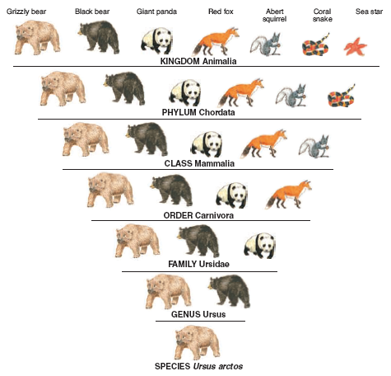
Dumb
King
Phillip
Came
Over
For
Gooseberry
Soup!

Slide 16
Domains
Broadest, most inclusive taxon
Three domains
Archaea and Bacteria are unicellular prokaryotes (no nucleus or membrane-bound organelles)
Eukarya are more complex and have a nucleus and membrane-bound organelles

Slide 17
ARCHAEA
Kingdom - ARCHAEBACTERIA
Probably the 1st cells to evolve
Live in HARSH environments
Found in:
Sewage Treatment Plants (Methanogens)
Thermal or Volcanic Vents (Thermophiles)
Hot Springs or Geysers that are acid
Very salty water (Dead Sea; Great Salt Lake) - Halophiles

Slide 18
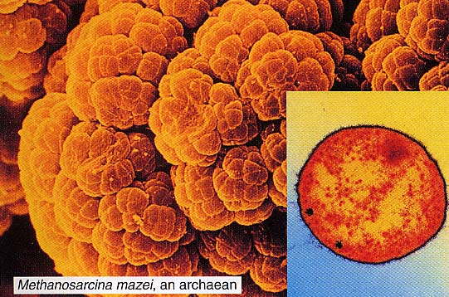
ARCHAEAN

Slide 19
BACTERIA
Kingdom - EUBACTERIA
Some may cause DISEASE
Found in ALL HABITATS except harsh ones
Important decomposers for environment
Commercially important in making cottage cheese, yogurt, buttermilk, etc.

Slide 20
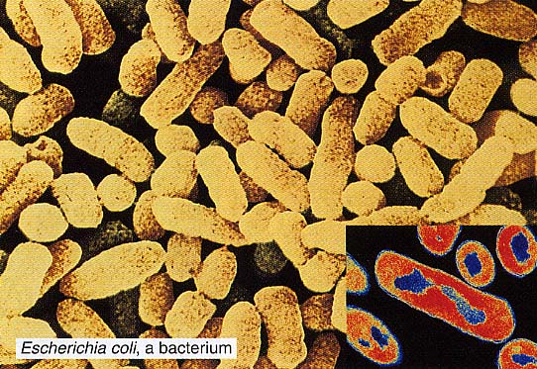
Live in the intestines of animals

Slide 21
Domain Eukarya is Divided into Kingdoms
Protista (protozoans, algae…)
Fungi (mushrooms, yeasts …)
Plantae (multicellular plants)
Animalia (multicellular animals)

Slide 22
Protista
Most are unicellular
Some are multicellular
Some are autotrophic, while others are heterotrophic
Aquatic

Slide 23
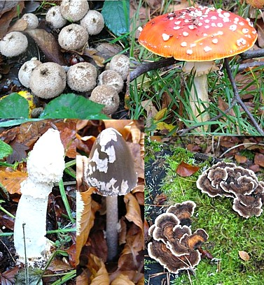
Fungi
Multicellular, except yeast
Absorptive heterotrophs (digest food outside their body & then absorb it)
Cell walls made of chitin

Slide 24
Plantae
Multicellular
Autotrophic
Absorb sunlight to make glucose – Photosynthesis
Cell walls made of cellulose
Notes:
Growth, with increases in size and number of cells, is part of development.
Development involves many stages from conception until death.

Slide 25
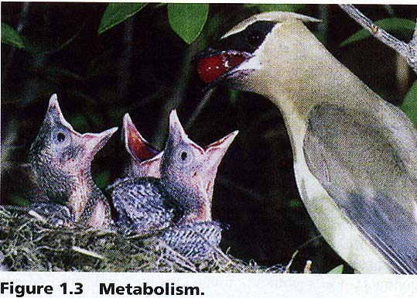
Animalia
Multicellular
Ingestive heterotrophs (consume food & digest it inside their bodies)
Feed on plants or animals

Slide 26
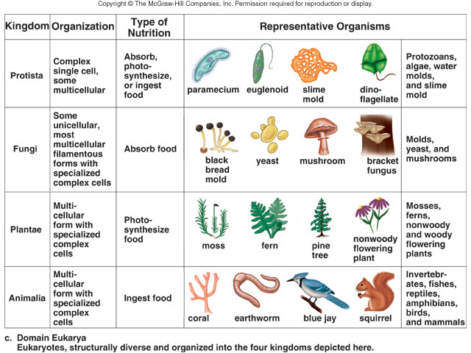

Slide 27
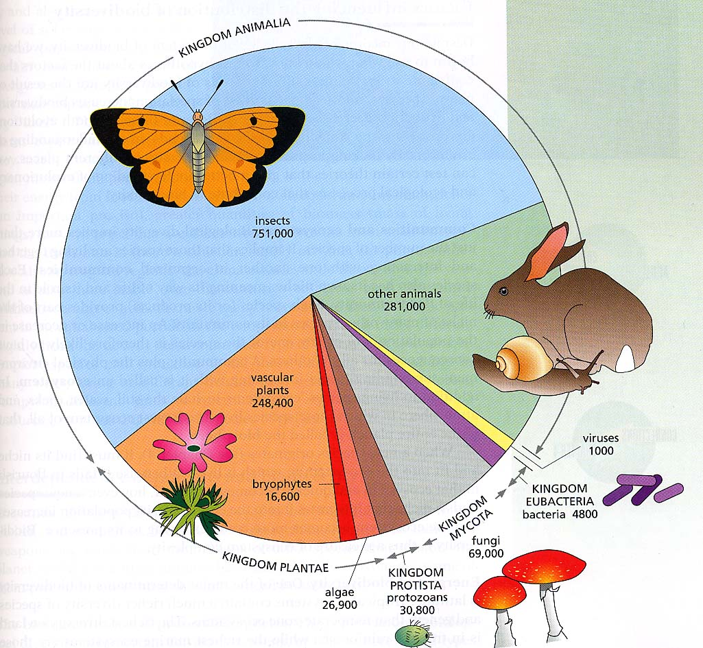

Slide 28
Basis for Modern Taxonomy
Homologous structures (same structure, different function)
Similar embryo development
Molecular Similarity in DNA, RNA, or amino acid sequence of Proteins

Slide 29
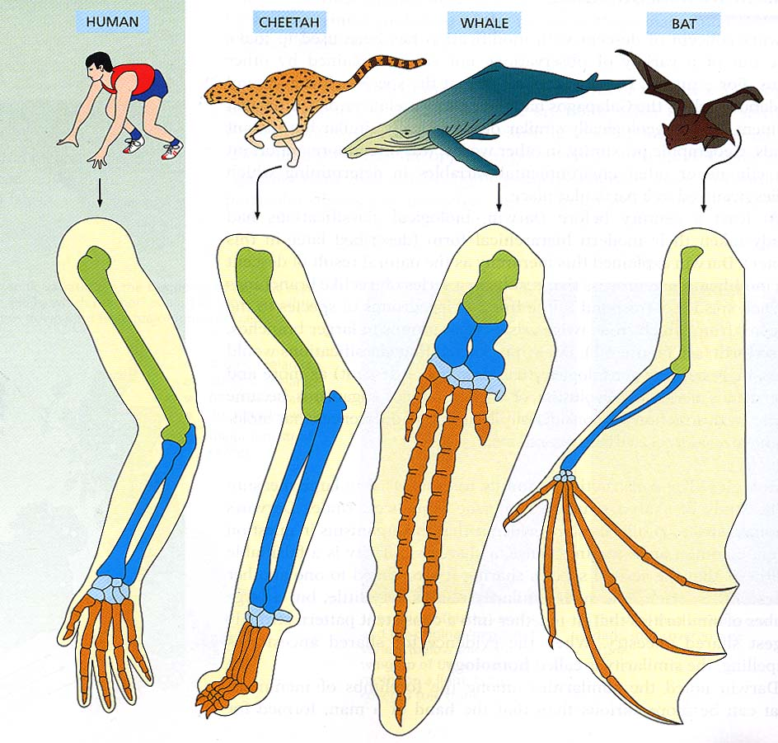
Homologous Structures (BONES in the FORELIMBS) shows Similarities in mammals.

Slide 30
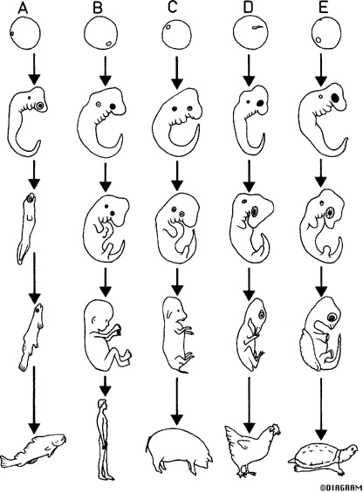
Similarities in Vertebrate Embryos

Slide 31
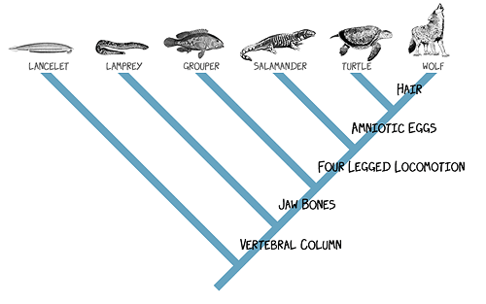
Cladogram
Diagram showing how organisms are related based on shared, derived characteristics such as feathers, hair, or scales

Slide 32
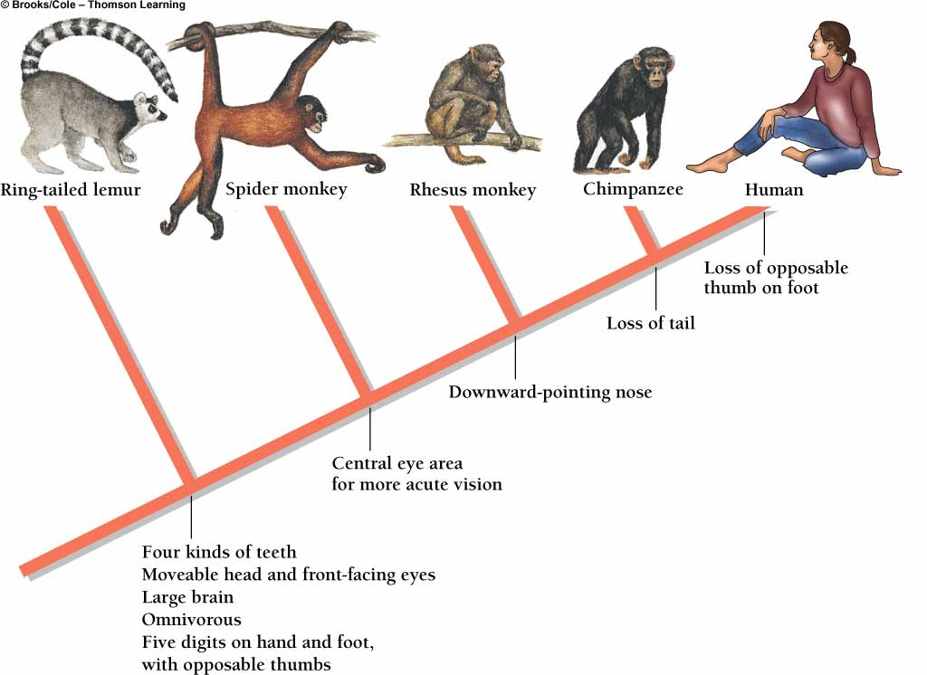
Primate Cladogram

Slide 33
Dichotomous Keying
Used to identify organisms
Characteristics given in pairs
Read both characteristics and either go to another set of characteristics OR identify the organism

Slide 34
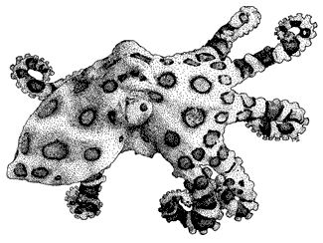
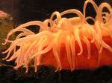
Example of Dichotomous Key
1a Tentacles present – Go to 2
1b Tentacles absent – Go to 4
2a Eight Tentacles – Octopus
2b More than 8 tentacles – 3
3a Tentacles hang down – go to 4
3b Tentacles upright–Sea Anemone
4a Balloon-shaped body–Jellyfish
4b Body NOT balloon-shaped - 5

