Slide 1
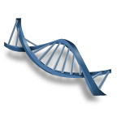
Cell Cycle, DNA, and Protein Synthesis

Slide 2
Cell Division
All cells are derived from
New cells are produced for growth and to replace
Differs in prokaryotes (bacteria) and eukaryotes (protists, fungi, plants, & animals)

Slide 3
DNA Replication
DNA must be copied or replicated before cell division
Each new cell will then have an identical copy of the DNA
Original DNA strand
Two new, identical DNA strands

Slide 4
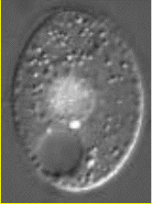
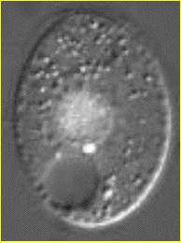
Identical Daughter Cells
Two identical daughter cells
Parent Cell

Slide 5
Chromosomes

Slide 6
Prokaryotic Chromosome
The DNA of prokaryotes (bacteria) is

Slide 7
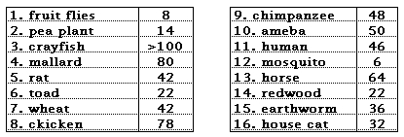
Do more chromosomes mean a more complex organism?

Slide 8
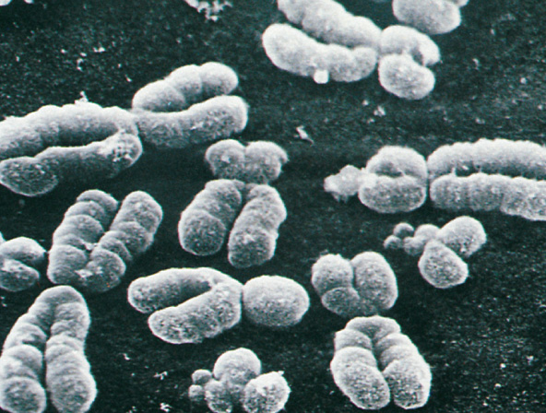
Eukaryotic Chromosomes
All cells store genetic information in chromosomes
Most eukaryotes have between 10 and 50 chromosomes in their body cells
Human body cells have individual chromosomes or 23 identical pairs

Slide 9
Eukaryotic Chromosomes
Each chromosome is composed of a single, tightly coiled molecule
Chromosomes can’t be seen when cells aren’t dividing and are called

Slide 10
Compacting DNA into Chromosomes
DNA is tightly coiled around proteins called

Slide 11
Chromosomes in Dividing Cells
Duplicated chromosomes are called
are held together by the
Called Sister Chromatids

Slide 12
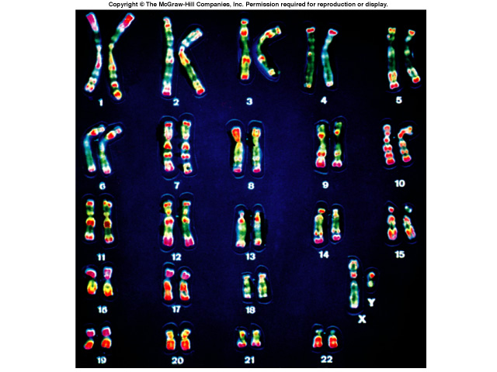
Karyotype
A picture of the chromosomes from a human cell arranged in pairs by size
First 22 pairs are called autosomes
Last pair are the sex chromosomes
XX female or XY male

Slide 13
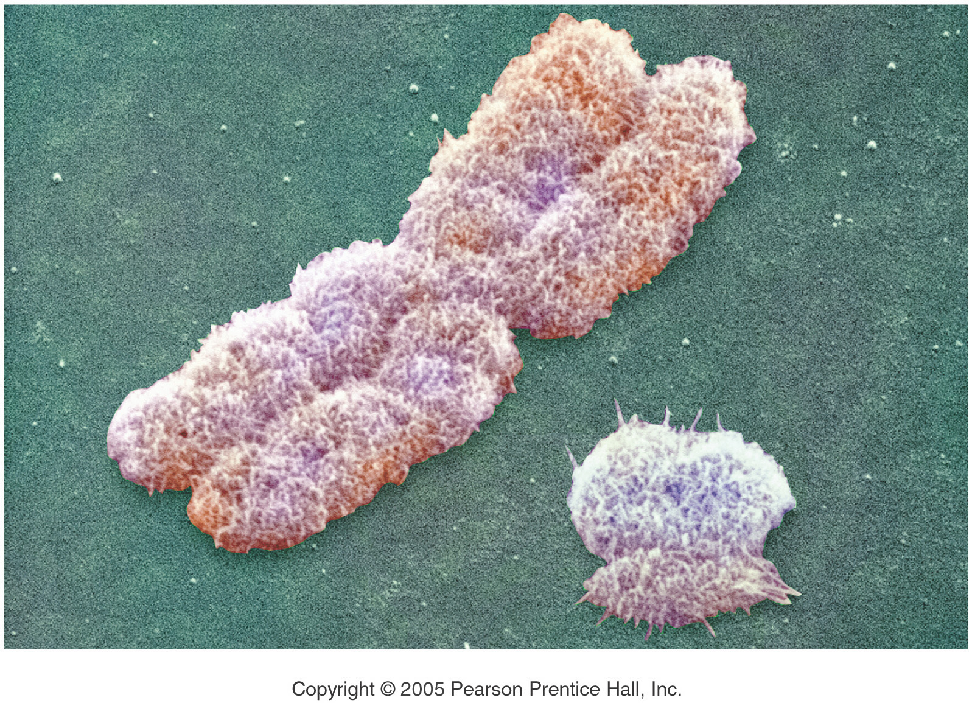
Boy or Girl?
The Y Chromosome Decides
Y - Chromosome
X - Chromosome

Slide 14
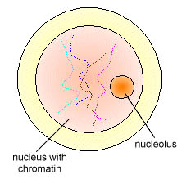
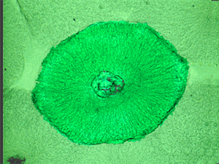
The Cell Cycle
We have learned that the basic unit of life is the cell.
Like all living things, the cell goes through a cycle of growth and reproduction.
The sequence of growth and division of a cell is called the
Most of the cell’s life is spent in the growth phase known as

Slide 15
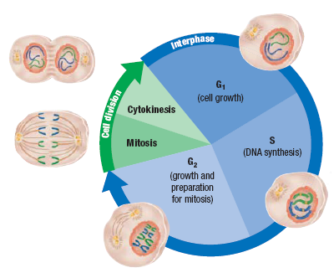
The Cell Cycle (see diagram on page 228)
Chromosomes are not visible (chromatin) Cell is rapidly growing and synthesizing proteins for daily functions
Cell divides the nucleus followed by cytoplasm division (cytokinesis) resulting in two identical daughter cells
- Cell is growing and producing proteins needed for mitosis
- Synthesis
Chromosomes are replicated to form a pair of sister chromatids connected by a centromere

Slide 16
Mitosis
During mitosis, one parent cell divides into identical daughter cells.
All cells (cells other than the sex cells that make eggs and sperm) undergo mitosis.
There are four phases of mitosis:
1.
2.
3.
4.

Slide 17
Prophase
This is the phase in mitosis.
1. The nuclear envelope
2. Chromatin coils to become visible
3. The two halves of the doubled structure are called sister
4. Sister chromatids are held together by a centromere.
5. In animal cells, the centrioles move to opposite ends of the cell and start to form spindle fibers

Slide 18
Metaphase
The second and shortest phase in mitosis
The spindle fibers attach to the
The sister chromatids are then pulled to the of the cell and line up on the midline or equator
One sister chromatid from each pair points to one pole while the other points to the opposite pole

Slide 19
The Spindle

Slide 20
Anaphase
The centromeres split and the sister chromatids are pulled to

Slide 21
Telophase
Chromosomes uncoil
Spindle is
Nuclear envelope
Cytokinesis begins

Slide 22
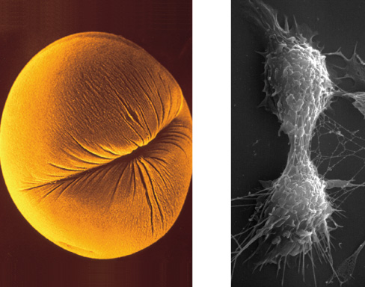
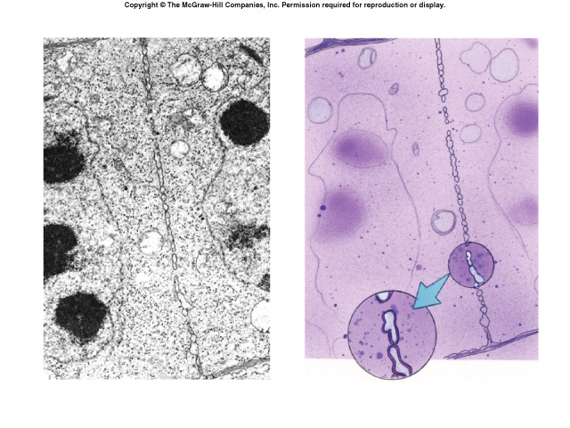
Cytokinesis
in animal cell
in animal cell

Slide 23
Cytokinesis
Cytoplasm is split forming two daughter cells each with its own
In animals: a
is formed that pinches the two cells apart
In plants: a forms the two new cells to start the formation of the cell wall (this does not occur in animal cells!)
Cell Plate

Slide 24
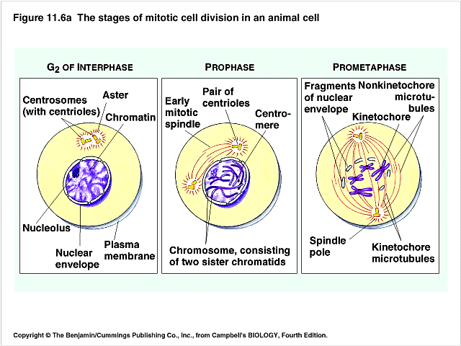
Draw & Learn these Stages

Slide 25
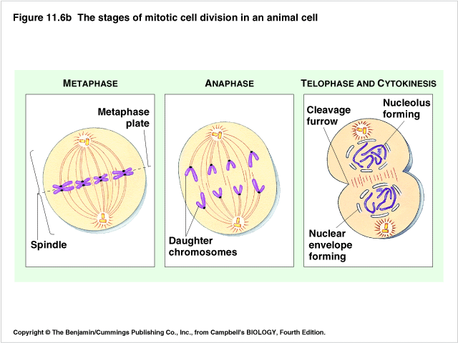
Draw & Learn these Stages

Slide 26
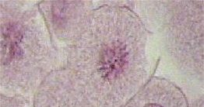
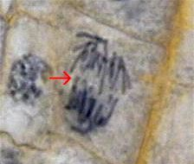
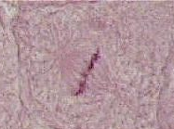
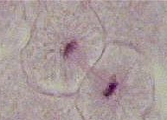
Name the Phase

Slide 27
Identify the Stages
?
Early, Middle, & Late Prophase
?
?
?
Metaphase
Anaphase
Late Prophase
?
?
?
Late Anaphase
Telophase
Telophase & Cytokinesis

Slide 28
Controlling the Cell Cycle
The cell cycle is driven by a chemical control system telling the cell when to turn on and off cell division
Internal signals – cell senses the presence of enzymes produced within the cell
External signals – cell senses the presence of chemicals (such as growth factors) produced by other specialized cells
Cells also respond to physical signals
When cells are
division is turned off
When cells are not in contact with other cells, division is turned on

Slide 29
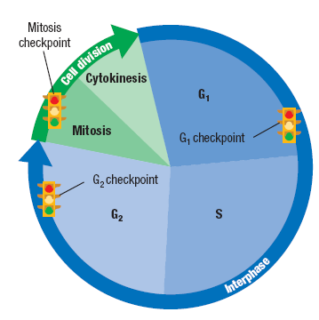
Controlling the Cell Cycle
The cycle control system is regulated at certain checkpoints
At each checkpoint, the cell decides if it should go on with division
G1 – makes sure conditions are favorable and cell is big enough for division
G2 – cell checks for any mistakes
Mitosis – cell makes sure chromosomes and spindle are arranged properly
Specific stimuli are required to initiate cell division. Cell division in most animal’s cells is in the “off” position when no stimulus is present

Slide 30
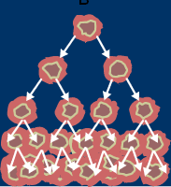
Mitosis Out of Control
Cancer cells are an example of cells that do not listen to the cell’s control system
Cancer cells even though they may be closely packed together or no growth factor is present.
Cancer begins as a __________________
This cell is normally found and destroyed by the body’s immune system. If not, this cell could divide into a mass of identical daughter cancer cells that:

Slide 31
Apoptosis
“ ”
Basically break the cell membrane to release the contents.
Nearby cells will clean up the remaining parts of the cell.
_________________ and Parkinson’s disease are associated with inappropriate apoptosis in cells.

Slide 32
Cancer
Cells lose ability to control growth causing rapid uncontrolled mitosis.
Tumors – mass of cells
does not spread to nearby tissue
– Spreads to other tissues
Absorb nutrients, block nerve connections, and prevent proper organ function.
Often caused by defects in genes that regulate cell growth.
Can be caused by smoking, radiation, viral infections, etc.

Slide 33
Cancer Treatments
Surgery- Cut out localized tumors (skin cancer)
Chemotherapy – drugs that target fast growing cells
Radiation therapy – targets the gap phase of cellular growth

Slide 34
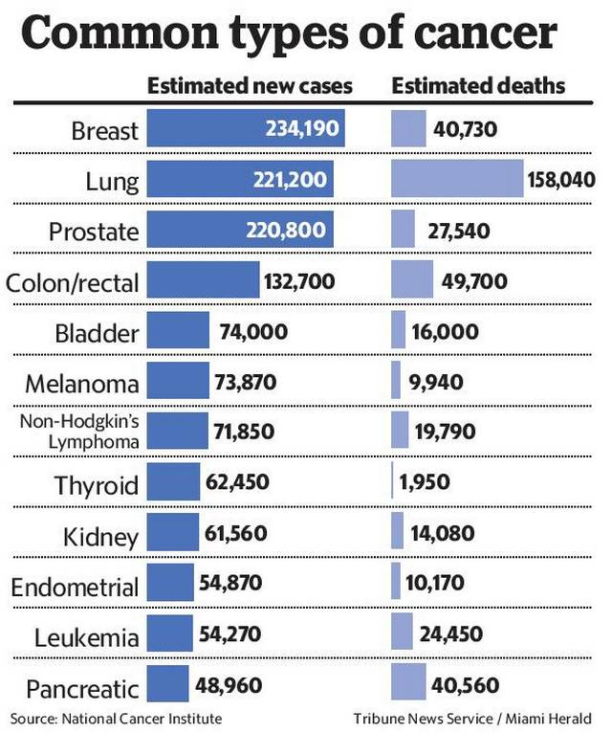

Slide 35
Cell Differentiation
100,000,000,000,000 100 trillion cells
Hundreds of unique types of functions in the human body
Stem cells = ( have the ability to be different types)
(embryonic stem cells ) can become any different type of tissue
(adult stem cells) can become more than one type of cell , but are limited to replacing the cells in the tissues they are found ( ex. Muscle, bone, brain)

Slide 36
Ethical Issues
– harvested directly from willing donor, few issues ethically.
Embryonic stem cells –
Induced pluripotent stem cells – tailor specific treatments to a patient by converted a fibroblast to resemble embryonic stem cells .

