Slide 1
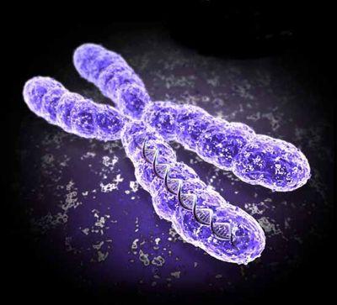
MEIOSIS

Slide 2
Bell Work 11/16
Recall- What are the steps of mitosis?
H.B.4C.1 Develop and use models of sex cell formation (meiosis) to explain why the DNA of the daughter cells is different from the DNA of the parent cell.

Slide 3
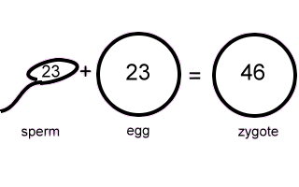
Meiosis
Meiosis is SEXUAL reproduction.
The form of cell division by which GAMETES (egg or sperm), with HALF the number of CHROMOSOMES, combine.
TWO divisions (MEIOSIS I and MEIOSIS II).

Slide 4
Meiosis
Sex cells divide to produce GAMETES (sperm or egg).
Gametes have HALF the # of chromosomes (23).
Occurs only in GONADS (testes or ovaries).

Slide 5
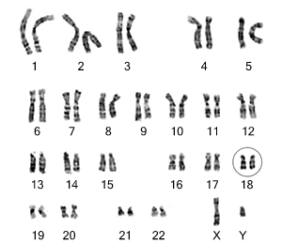
Meiosis
Diploid (2n) – 2 copies of each chromosome, one from each parent.
Haploid (1n) – egg or sperm cells only, only have one copy of each chromosome
Karyotype- all of
The chromosomes

Slide 6
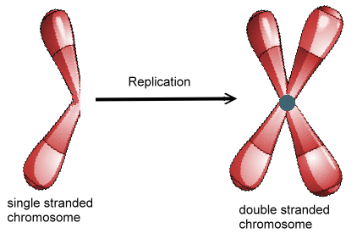
Interphase I
Similar to mitosis interphase.
CHROMOSOMES (DNA) replicate in the S phase
Each duplicated chromosome consist of two identical SISTER CHROMATIDS attached at their CENTROMERES.

Slide 7
Interphase I
Nucleus and nucleolus visible.
Nucleus
chromatin
cell membrane
nucleolus

Slide 8
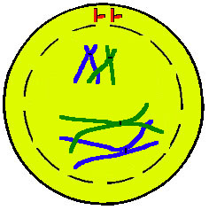
Meiosis I (four phases)
Cell division that reduces the chromosome number by one-half.
Four phases:
a. Prophase I
b. Metaphase I
c. Anaphase I
d. Telophase I
Prophase I

Slide 9
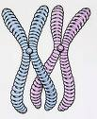
Prophase I
Longest and most complex phase (90%).
Chromosomes condense.
Synapsis occurs - Homologous chromosomes come together to form a tetrad.
Tetrad is two chromosomes or four chromatids (sister and non-sister chromatids).

Slide 10
Prophase I - Synapsis
Homologous chromosomes
sister chromatids
sister chromatids
Tetrad

Slide 11
HOMOLOGS
Homologs contain DNA that codes for the same genes , but different versions of those genes
Genes occur at the same loci

Slide 12
Homologous Chromosomes
Pair of chromosomes (maternal and paternal) that are similar in shape and size.
Homologous pairs (tetrads) carry GENES controlling the SAME inherited traits.
Each locus (position of a gene) is in the same position on homologues.
Humans have 23 pairs of homologous chromosomes:
a. First 22 pairs of autosomes
b. Last pair of sex chromosomes
LOCI

Slide 13
Homologous Chromosomes
eye color
locus
eye color
locus
hair color
locus
hair color
locus
Paternal
Maternal

Slide 14
Crossing Over
Crossing over may occur between non-sister chromatids at sites called chiasmata.
Crossing over: segments of nonsister chromatids break and reattach to the other chromatid.
Chiasmata (chiasma) are where chromosomes touch each other and exchange genes (crossing over.)
Causes Genetic Recombination

Slide 15
Genetic Recombination
nonsister chromatids
Tetrad
chiasmata: site of crossing over
variation

Slide 16
Sex Chromosomes
XX chromosome - female
XY chromosome - male

Slide 17
Prophase I
Nucleus & Nucleolus disappear
Spindle forms
Chromosomes coil & Synapsis (pairing) occurs
Tetrads form & Crossing over Occurs
spindle fiber
centrioles
aster
fibers
TETRAD

Slide 18
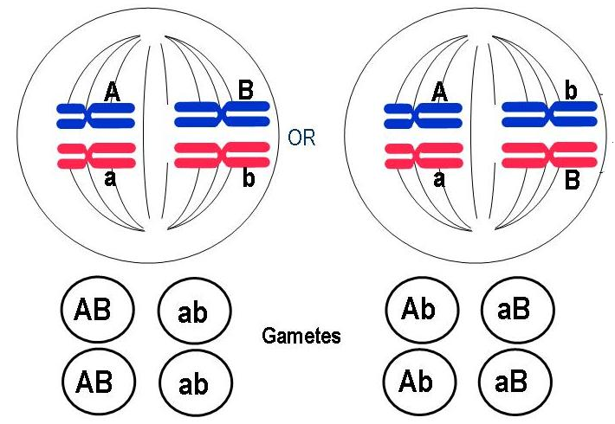
Metaphase I
Shortest phase
Tetrads align on the equator.
Independent assortment occurs – chromosomes separate randomly causing GENETIC RECOMBINATION

Slide 19
Metaphase I
OR
Homologs line up at equator or metaphase plate

Slide 20
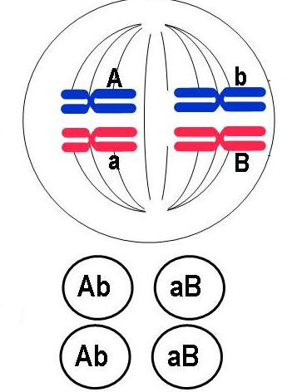
Formula: 2^{n}
Example: 2n = 4
then 1n = 2
thus 2² = 4 combinations

Slide 21
Question:
In terms of Independent Assortment -how many different combinations of sperm could a human male produce?

Slide 22
Answer
Formula: 2^{n}
Human chromosomes: 2n = 46
n = 23
2²³ = ~8 million combinations

Slide 23
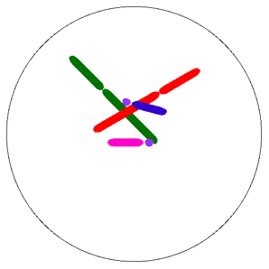
Anaphase I
Homologous chromosomes separate and move towards the poles.
Sister chromatids remain attached at their centromeres.

Slide 24
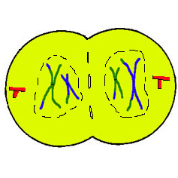
Telophase I
Each pole now has haploid (1n) set of chromosomes.
Cytokinesis occurs and two haploid daughter cells are formed.

Slide 25
Telophase I
cytokinesis

Slide 26
MEIOSIS II
Sister Chromatids Separate
Meiosis II

Slide 27
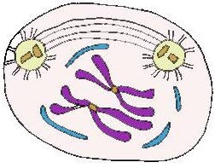
Meiosis II
No Interphase II or very short
No DNA Replication
Remember: Meiosis II is similar to mitosis

Slide 28
Prophase II
Same as Prophase in mitosis
Nucleus & nucleolus disappear
Chromosomes condense
Spindle forms

Slide 29
Metaphase II
Same as Metaphase in mitosis
Chromosomes (not homologs) line up at equator

Slide 30
Anaphase II
Same as Anaphase in mitosis
SISTER CHROMATIDS separate

Slide 31
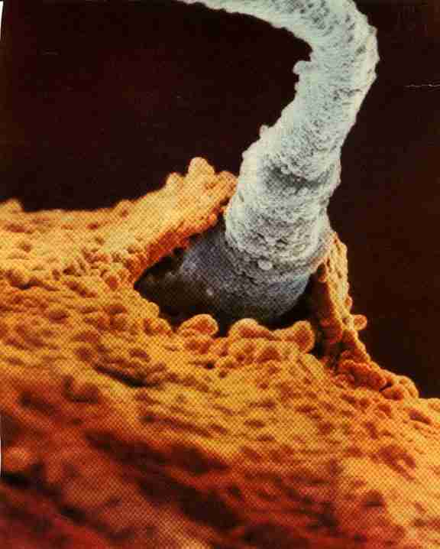
Telophase II
Same as Telophase in mitosis.
Nuclei and Nucleoli reform, spindle disappears
CYTOKINESIS occurs.
Remember: FOUR HAPLOID DAUGHTER cells are produced.
Called GAMETES (eggs and sperm)
1n Sperm cell fertilizes 1n egg to form 2n zygote

Slide 32
Telophase II

Slide 33
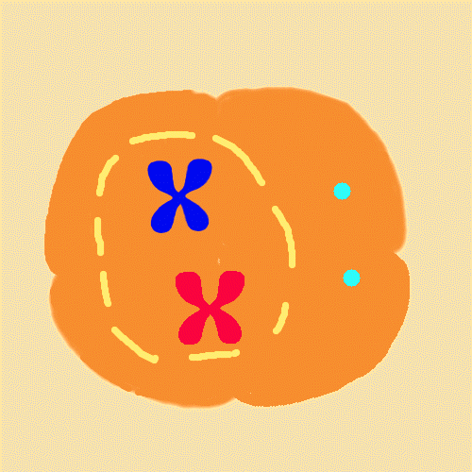

Slide 34
Question:
What are the 3 sources of genetic recombination or variation?

Slide 35
Answer:
CROSSING OVER (prophase I)
INDEPENDENT ASSORTMENT (metaphase I)
RANDOM FERTILIZATION

Slide 36
Question:
A cell containing 20 chromosomes (diploid) at the beginning of meiosis would, at its completion, produce cells containing how many chromosomes?

Slide 37
Answer:
10 chromosomes (haploid or 1n)

Slide 38
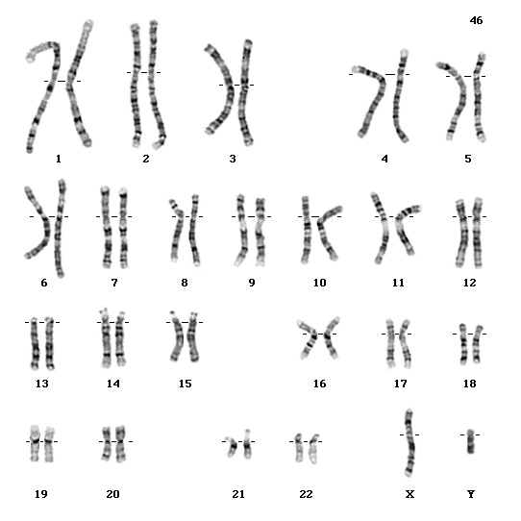
Karyotype
An organized picture of the chromosomes of a human arranged in pairs by size from largest to smallest.
Pairs 1-22 called AUTOSOMES
Last pair are SEX CHROMOSOMES
Male - XY

Slide 39
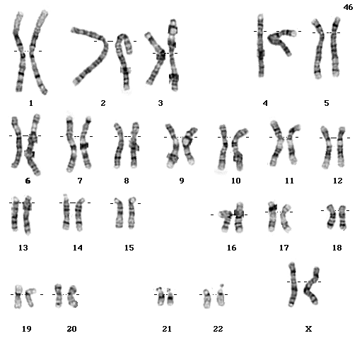
Karyotype
Female - XX

Slide 40
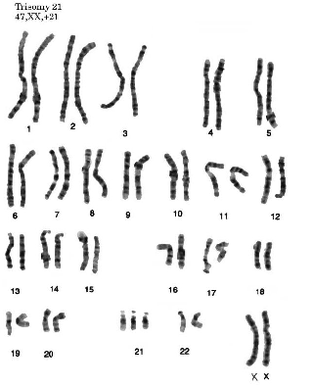
Karyotype
Down Syndrome – Trisomy 21
Female - XX

Slide 41
Fertilization
The fusion of a sperm and egg to form a zygote.
A zygote is a FERTILIZED EGG
sperm
n=23
n=23
egg
2n=46
zygote

Slide 42
Question:
A cell containing 40 chromatids at the beginning of meiosis would, at its completion, produce cells containing how many chromosomes?

Slide 43
Answer:
10 chromosomes

Slide 44
Mendelelian Genetics

Slide 45
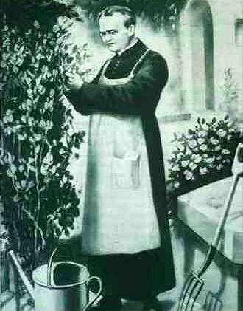
Gregor Mendel (1822-1884)
Responsible for the Laws governing Inheritance of Traits

Slide 46
Gregor Johann Mendel
Austrian monk
Studied the inheritance of traits in pea plants
Developed the laws of inheritance
Mendel's work was not recognized until the turn of the 20th century

Slide 47
Gregor Johann Mendel
Between 1856 and 1863, Mendel cultivated and tested some 28,000 pea plants
He found that the plants' offspring retained traits of the parents
Called the “Father of Genetics"

Slide 48
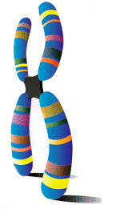
Particulate Inheritance
Mendel stated that physical traits are inherited as “particles”
Mendel did not know that the “particles” were actually Chromosomes & DNA

Slide 49
Genetic Terminology
Trait - any characteristic that can be passed from parent to offspring
Heredity - passing of traits from parent to offspring
Genetics - study of heredity

Slide 50
Types of Genetic Crosses
Monohybrid cross - cross involving a single trait e.g. flower color
Dihybrid cross - cross involving two traits e.g. flower color & plant height

Slide 51
Punnett Square
Used to help solve genetics problems

Slide 52
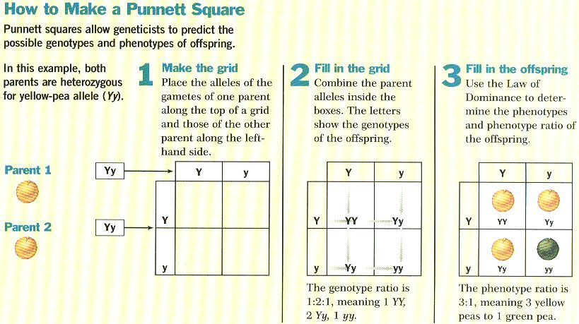

Slide 53
Designer “Genes”
Alleles - two forms of a gene (dominant & recessive)
Dominant - stronger of two genes expressed in the hybrid; represented by a capital letter (R)
Recessive - gene that shows up less often in a cross; represented by a lowercase letter (r)

Slide 54
More Terminology
Genotype - gene combination for a trait (e.g. RR, Rr, rr)
Phenotype - the physical feature resulting from a genotype (e.g. red, white)

Slide 55
Genotype & Phenotype in Flowers
Genotype of alleles: R = red flower r = yellow flower
All genes occur in pairs, so 2 alleles affect a characteristic
Possible combinations are:
Genotypes RR Rr rr
Phenotypes RED RED YELLOW

Slide 56
Genotypes
Homozygous genotype - gene combination involving 2 dominant or 2 recessive genes (e.g. RR or rr); also called pure
Heterozygous genotype - gene combination of one dominant & one recessive allele (e.g. Rr); also called hybrid

Slide 57
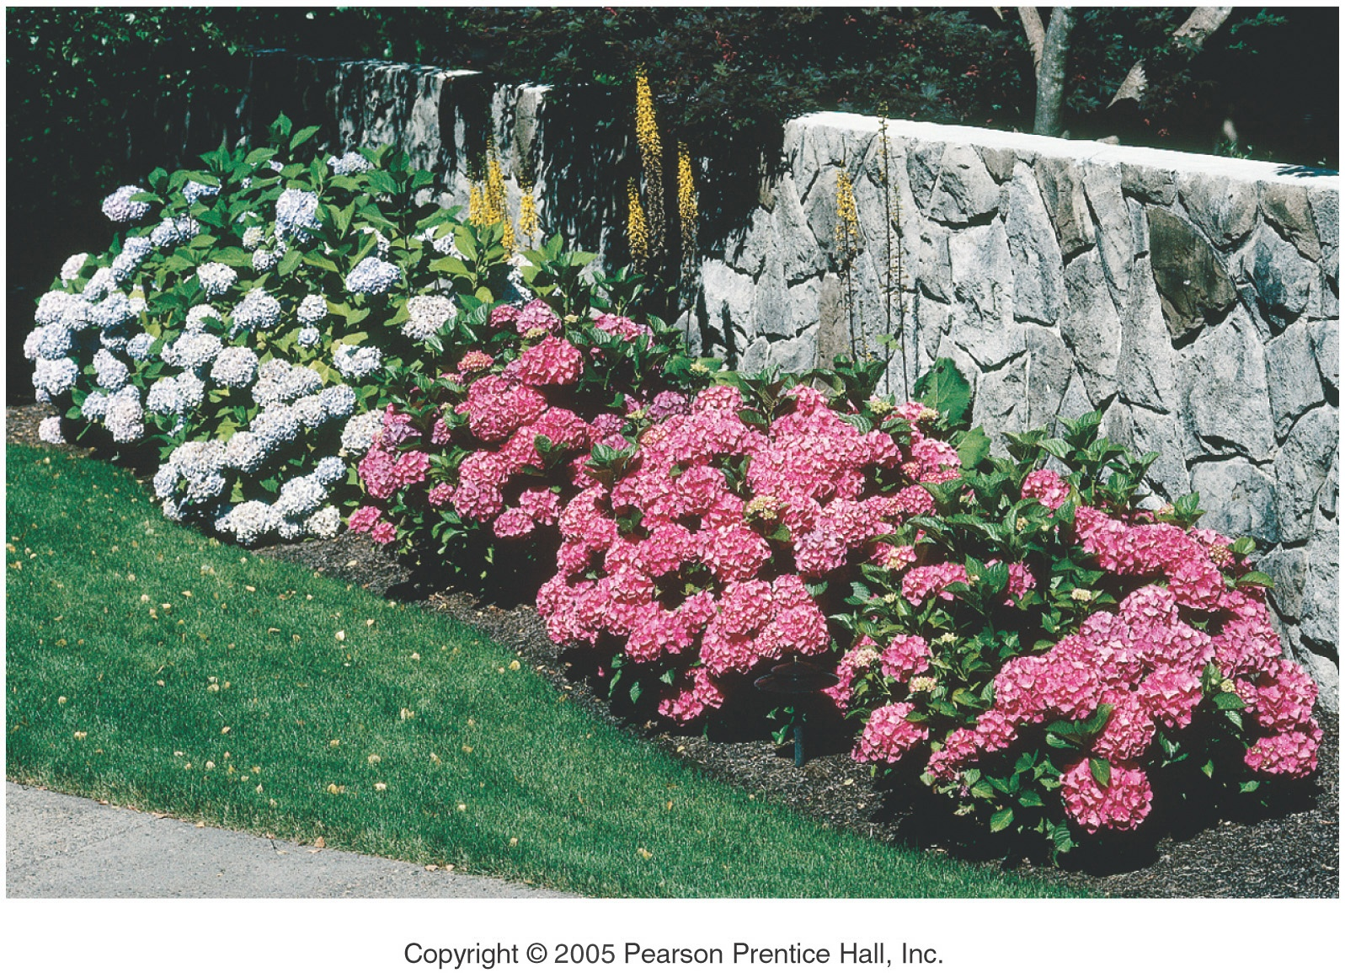
Genes and Environment Determine Characteristics

Slide 58
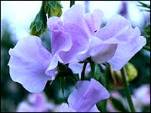
Mendel’s Pea Plant Experiments

Slide 59
Generation “Gap”
Parental P₁ Generation = the parental generation in a breeding experiment.
F₁ generation = the first-generation offspring in a breeding experiment. (1st filial generation)
From breeding individuals from the P₁ generation
F₂ generation = the second-generation offspring in a breeding experiment. (2nd filial generation)
From breeding individuals from the F₁ generation

Slide 60
Following the Generations
Cross 2 Pure Plants TT x tt
Results in all Hybrids Tt
Cross 2 Hybrids get 3 Tall & 1 Short TT, Tt, tt

Slide 61
Monohybrid Crosses

Slide 62
P₁ Monohybrid Cross
Trait: Seed Shape
Alleles: R – Round r – Wrinkled
Cross: Round seeds x Wrinkled seeds
RR x rr
Genotype: Rr
Phenotype: Round
Genotypic Ratio: All alike
Phenotypic Ratio: All alike
r
r
R
Rr
Rr
R
Rr
Rr

Slide 63
F₁ Monohybrid Cross
Trait: Seed Shape
Alleles: R – Round r – Wrinkled
Cross: Round seeds x Round seeds
Rr x Rr
Genotype: RR, Rr, rr
Phenotype: Round & wrinkled
G.Ratio: 1:2:1
P.Ratio: 3:1
R
r
R
RR
Rr
r
Rr
rr

Slide 64
F₁ Monohybrid Cross Review
Heterozygous x heterozygous
Offspring: 25% Homozygous dominant RR 50% Heterozygous Rr 25% Homozygous Recessive rr
Offspring called F₂ generation
Genotypic ratio is 1:2:1
Phenotypic Ratio is 3:1

Slide 65
Law of Dominance

Slide 66
Law of Segregation
During the formation of gametes (eggs or sperm), the two alleles responsible for a trait separate from each other.
Alleles for a trait are then "recombined" at fertilization, producing the genotype for the traits of the offspring.

Slide 67
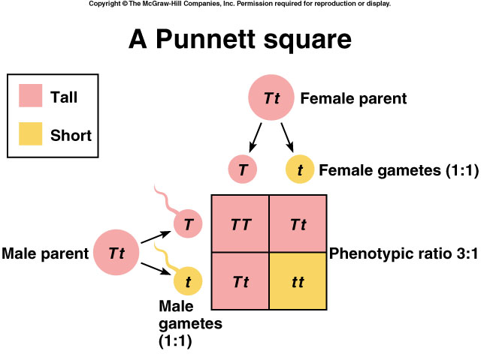
Applying the Law of Segregation

Slide 68
Law of Independent Assortment
Alleles for different traits are distributed to sex cells (& offspring) independently of one another.
This law can be illustrated using dihybrid crosses.

Slide 69
Dihybrid Cross
A breeding experiment that tracks the inheritance of two traits.
Mendel’s “Law of Independent Assortment”
a. Each pair of alleles segregates independently during gamete formation
b. Formula: 2^{n} (n = # of heterozygotes)

Slide 70
Question: How many gametes will be produced for the following allele arrangements?
Remember: 2^{n} (n = # of heterozygotes)
1. RrYy
2. AaBbCCDd
3. MmNnOoPPQQRrssTtQq

Slide 71
Answer:
1. RrYy: 2^{n} = 2² = 4 gametes
RY Ry rY ry
2. AaBbCCDd: 2^{n} = 2³ = 8 gametes
ABCD ABCd AbCD AbCd
aBCD aBCd abCD abCD
3. MmNnOoPPQQRrssTtQq: 2^{n} = 2⁶ = 64 gametes

Slide 72
Dihybrid Cross
Traits: Seed shape & Seed color
Alleles: R round r wrinkled Y yellow y green
RrYy x RrYy
RY Ry rY ry
RY Ry rY ry
All possible gamete combinations

Slide 73
Dihybrid Cross
RY
Ry
rY
ry
RY
Ry
rY
ry

Slide 74
Dihybrid Cross
RY
Ry
rY
ry
RY
Round/Yellow: 9
Round/green: 3
wrinkled/Yellow: 3
wrinkled/green: 1
RRYY
RRYy
RrYY
RrYy
Ry
RRYy
RRyy
RrYy
Rryy
rY
RrYY
RrYy
rrYY
rrYy
ry
RrYy
Rryy
rrYy
rryy
9:3:3:1 phenotypic ratio

Slide 75
Dihybrid Cross
Round/Yellow: 9 Round/green: 3 wrinkled/Yellow: 3 wrinkled/green: 1
9:3:3:1

Slide 76
Summary of Mendel’s laws
LAW
PARENT CROSS
OFFSPRING
DOMINANCE
TT x tt tall x short
100% Tt tall
SEGREGATION
Tt x Tt tall x tall
75% tall 25% short
INDEPENDENT ASSORTMENT
RrGg x RrGg round & green x round & green
9/16 round seeds & green pods 3/16 round seeds & yellow pods 3/16 wrinkled seeds & green pods 1/16 wrinkled seeds & yellow pods

Slide 77
Incomplete Dominance and Codominance

Slide 78
Incomplete Dominance
F1 hybrids have an appearance somewhat in between the phenotypes of the two parental varieties.
Example: snapdragons (flower)
red (RR) x white (rr)
RR = red flower
rr = white flower
r
r
R
R

Slide 79
Incomplete Dominance
r
r
produces the
F₁ generation
R
Rr
Rr
R
Rr
Rr
All Rr = pink
(heterozygous pink)

Slide 80
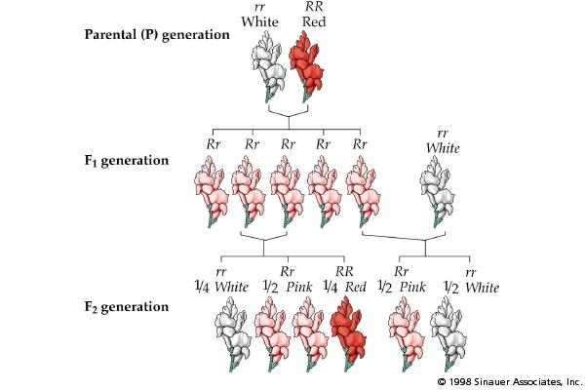
Incomplete Dominance

Slide 81
Codominance
Two alleles are expressed (multiple alleles) in heterozygous individuals.
Example: blood type
1. type A = I^{A}I^{A} or I^{A}i
2. type B = I^{B}I^{B} or I^{B}i
3. type AB = I^{A}I^{B}
4. type O = ii

Slide 82
Codominance Problem
Example: homozygous male Type B (I^{B}I^{B})
x heterozygous female Type A (I^{A}i)
I^{A}
i
I^{A}I^{B}
I^{B}i
I^{B}
1/2 = I^{A}I^{B}
1/2 = I^{B}i
I^{B}
I^{A}I^{B}
I^{B}i

Slide 83
Another Codominance Problem
Example: male Type O (ii) x female type AB (I^{A}I^{B})
I^{A}
I^{B}
i
I^{A}i
I^{B}i
1/2 = I^{A}i
1/2 = I^{B}i
i
I^{A}i
I^{B}i

Slide 84
Codominance
Question: If a boy has a blood type O and his sister has blood type AB, what are the genotypes and phenotypes of their parents?
boy - type O (ii) X girl - type AB (I^{A}I^{B})

Slide 85
Codominance
Answer:
I^{A}
i
I^{B}
I^{A}I^{B}
Parents:
genotypes = I^{A}i and I^{B}i
phenotypes = A and B
i
ii

Slide 86
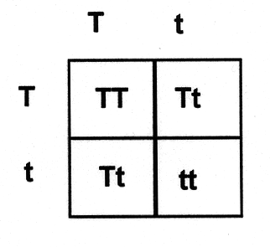
Genetic Practice Problems

